Slide 2

Accelerating Generative AI application development with Llama Stack
Ravikanth Chaganti
Distinguished Engineer, Dell Technologies
Azure Cloud Native MVP & Author

Slide 3
Why Llama Stack?
A generative AI application has many moving parts
Open Source is challenging without knowing what is supported
The barrier to entry is higher
It isn’t trivial to try models in different environments (cloud and on-prem)

Slide 4
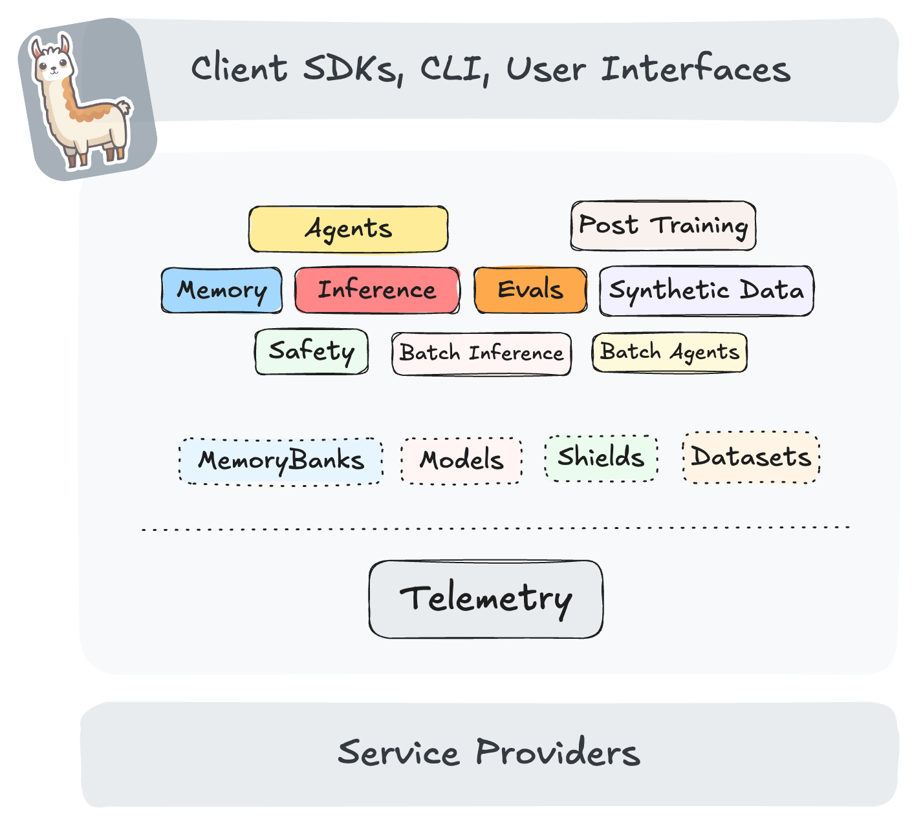
Introducing Llama Stack
An open-source framework for building generative AI applications using standard building blocks
Offers standard APIs for
Agentic applications
Model Life Cycle

Slide 5
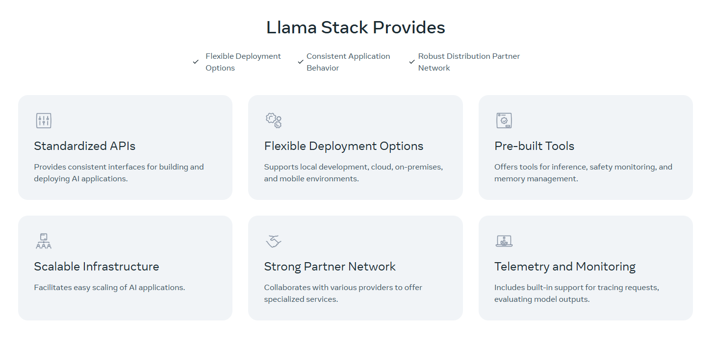
Llama Stack Features

Slide 6
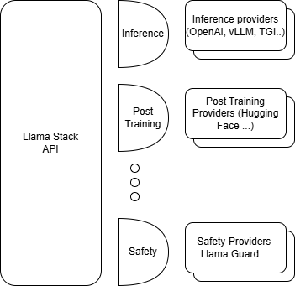
Llama Stack Adapters
Adapters enable access to a provider
Enable swapping out different implementations for the same API.
LLM inference providers (e.g., Fireworks, Together, AWS Bedrock, Groq, Cerebras, SambaNova, vLLM, etc.),
Vector databases (e.g., ChromaDB, Weaviate, Qdrant, Milvus, FAISS, PGVector, etc.),
Safety providers (e.g., Meta’s Llama Guard, AWS Bedrock Guardrails, etc.)
Come in two flavors
Remote
Inline (at least one)

Slide 7
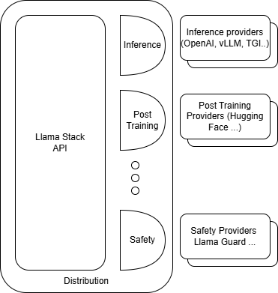
Llama Stack Distributions
A specific set of pre-packaged versions of the Llama Stack API and providers.
Called a Llama Stack Distribution
Three distro types
Remotely hosted
Locally hosted
On-device

Slide 8
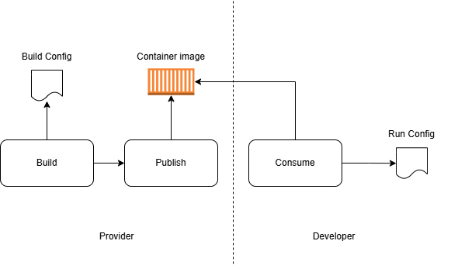
Llama Stack Workflow

Slide 9
Demo

Slide 11

Next Session
Integrating Azure AI services into business workflows
Yug Malik
AI & Digital Strategy Expert

